Slide 1
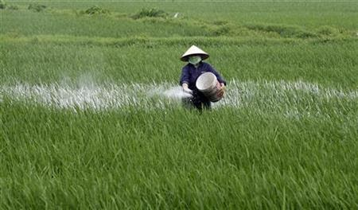
Name of Students: 1)Sandip Kshirsagar (Mech.) [e-mail: kshirsagarsandip091@gmail.com Contact-7058213163] & Vaishnavi Mali(CSE)(TE) [e-mail: vaishnavimali0459@gmail.com Contact-8380024459]
Business Plan name :
Agriculture Fertilizer’s Automation

Slide 2

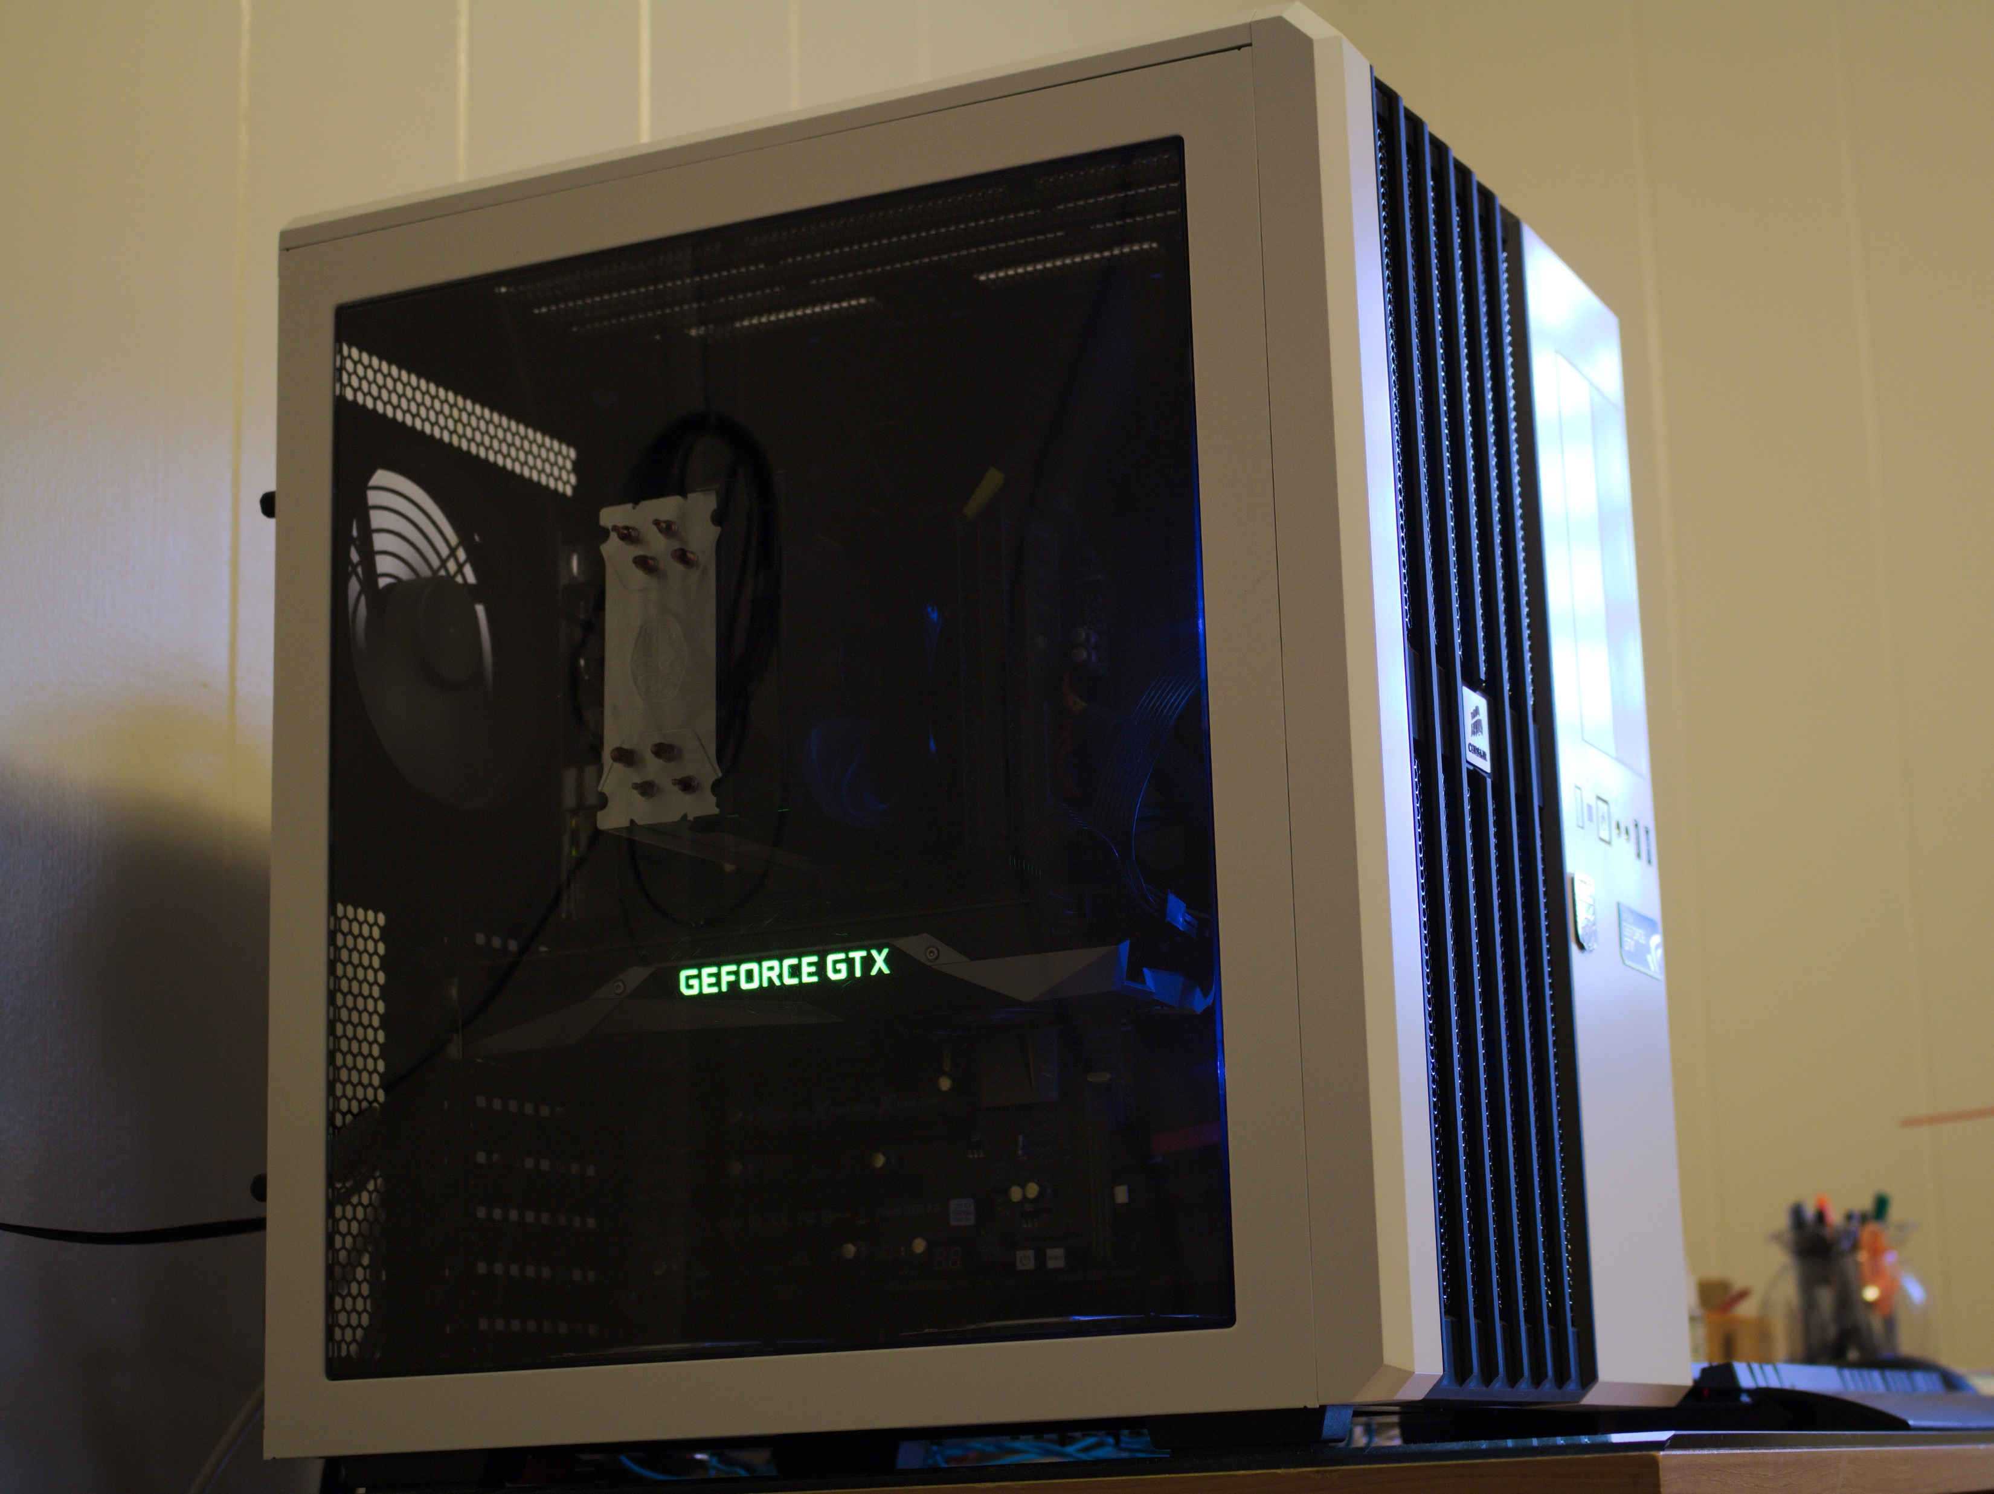
01. Introduction 02. Farmer’s current problems 03. What is Automation ? 04. Techniques how to handle(testing) 05. Programme setup 06. Sensors used 07. Budget of Product 08. Advantages to farmers
Contents:
Machine Design Like

Slide 3


A process of programmed commands combined with automatic feedback control to ensure proper execution of the instructions.
Automation:

Slide 4
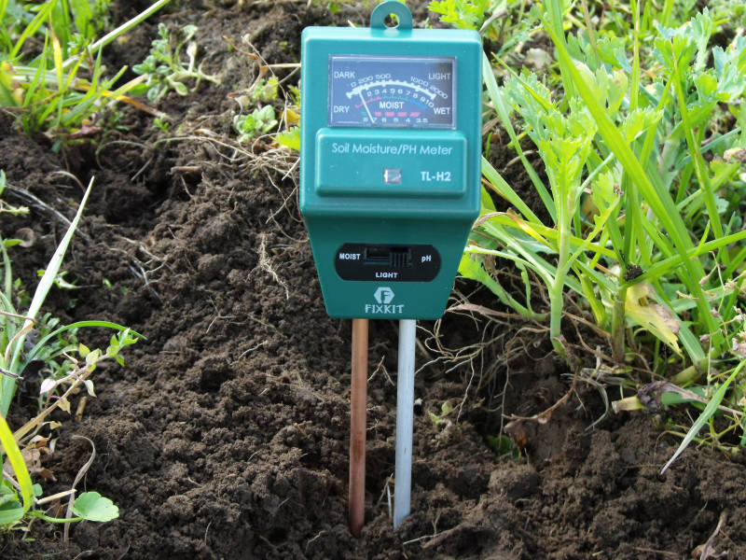

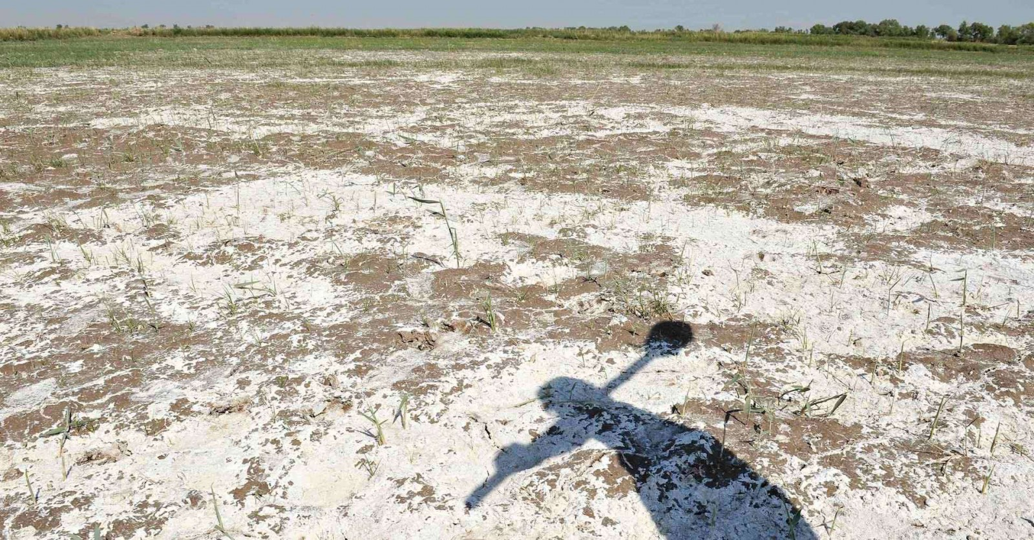
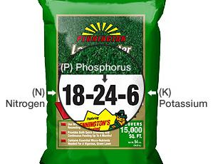
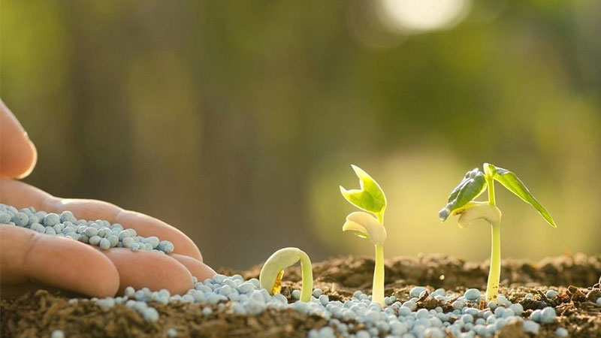
Soil Testing
Water Testing
Water Salt Management
Farmer’s Current Problems
Which Fertilizer’s Uses
Quantity of Fertilizers

Slide 5
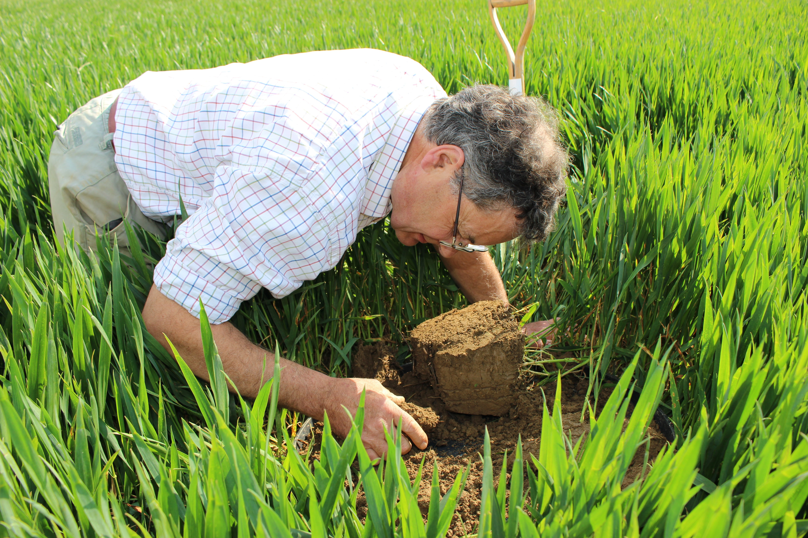

How machine of fertilizer’s Work:
Input Soil Sample
Result’s of Soil Content’s
Quantity of Fertilizers Output
Input of Water Sample
Result of Water Sample
Water Distillation Technique
Whether broadcasting

Slide 6
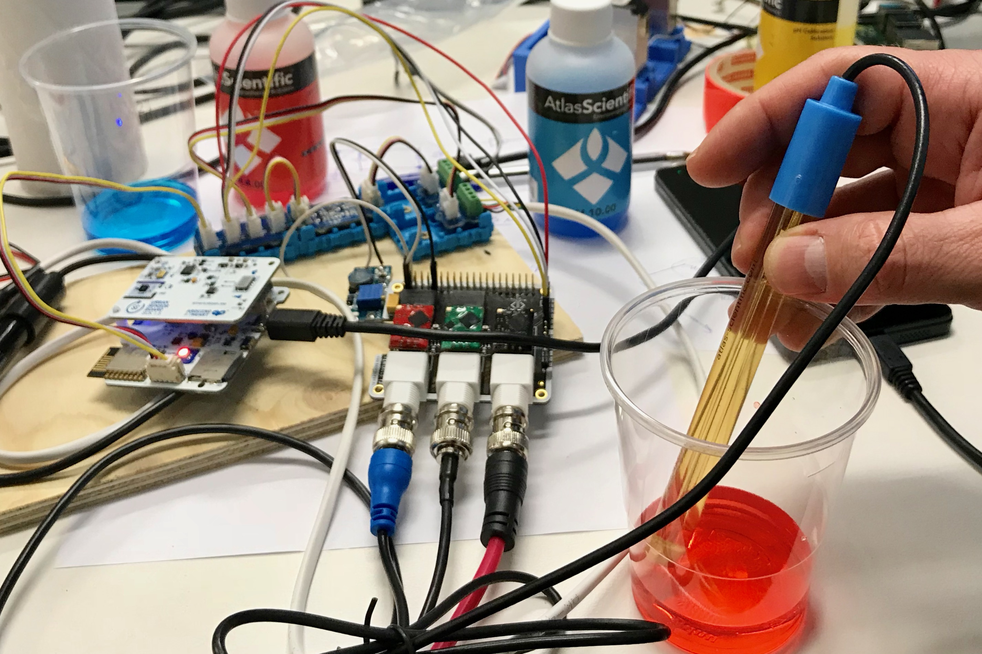
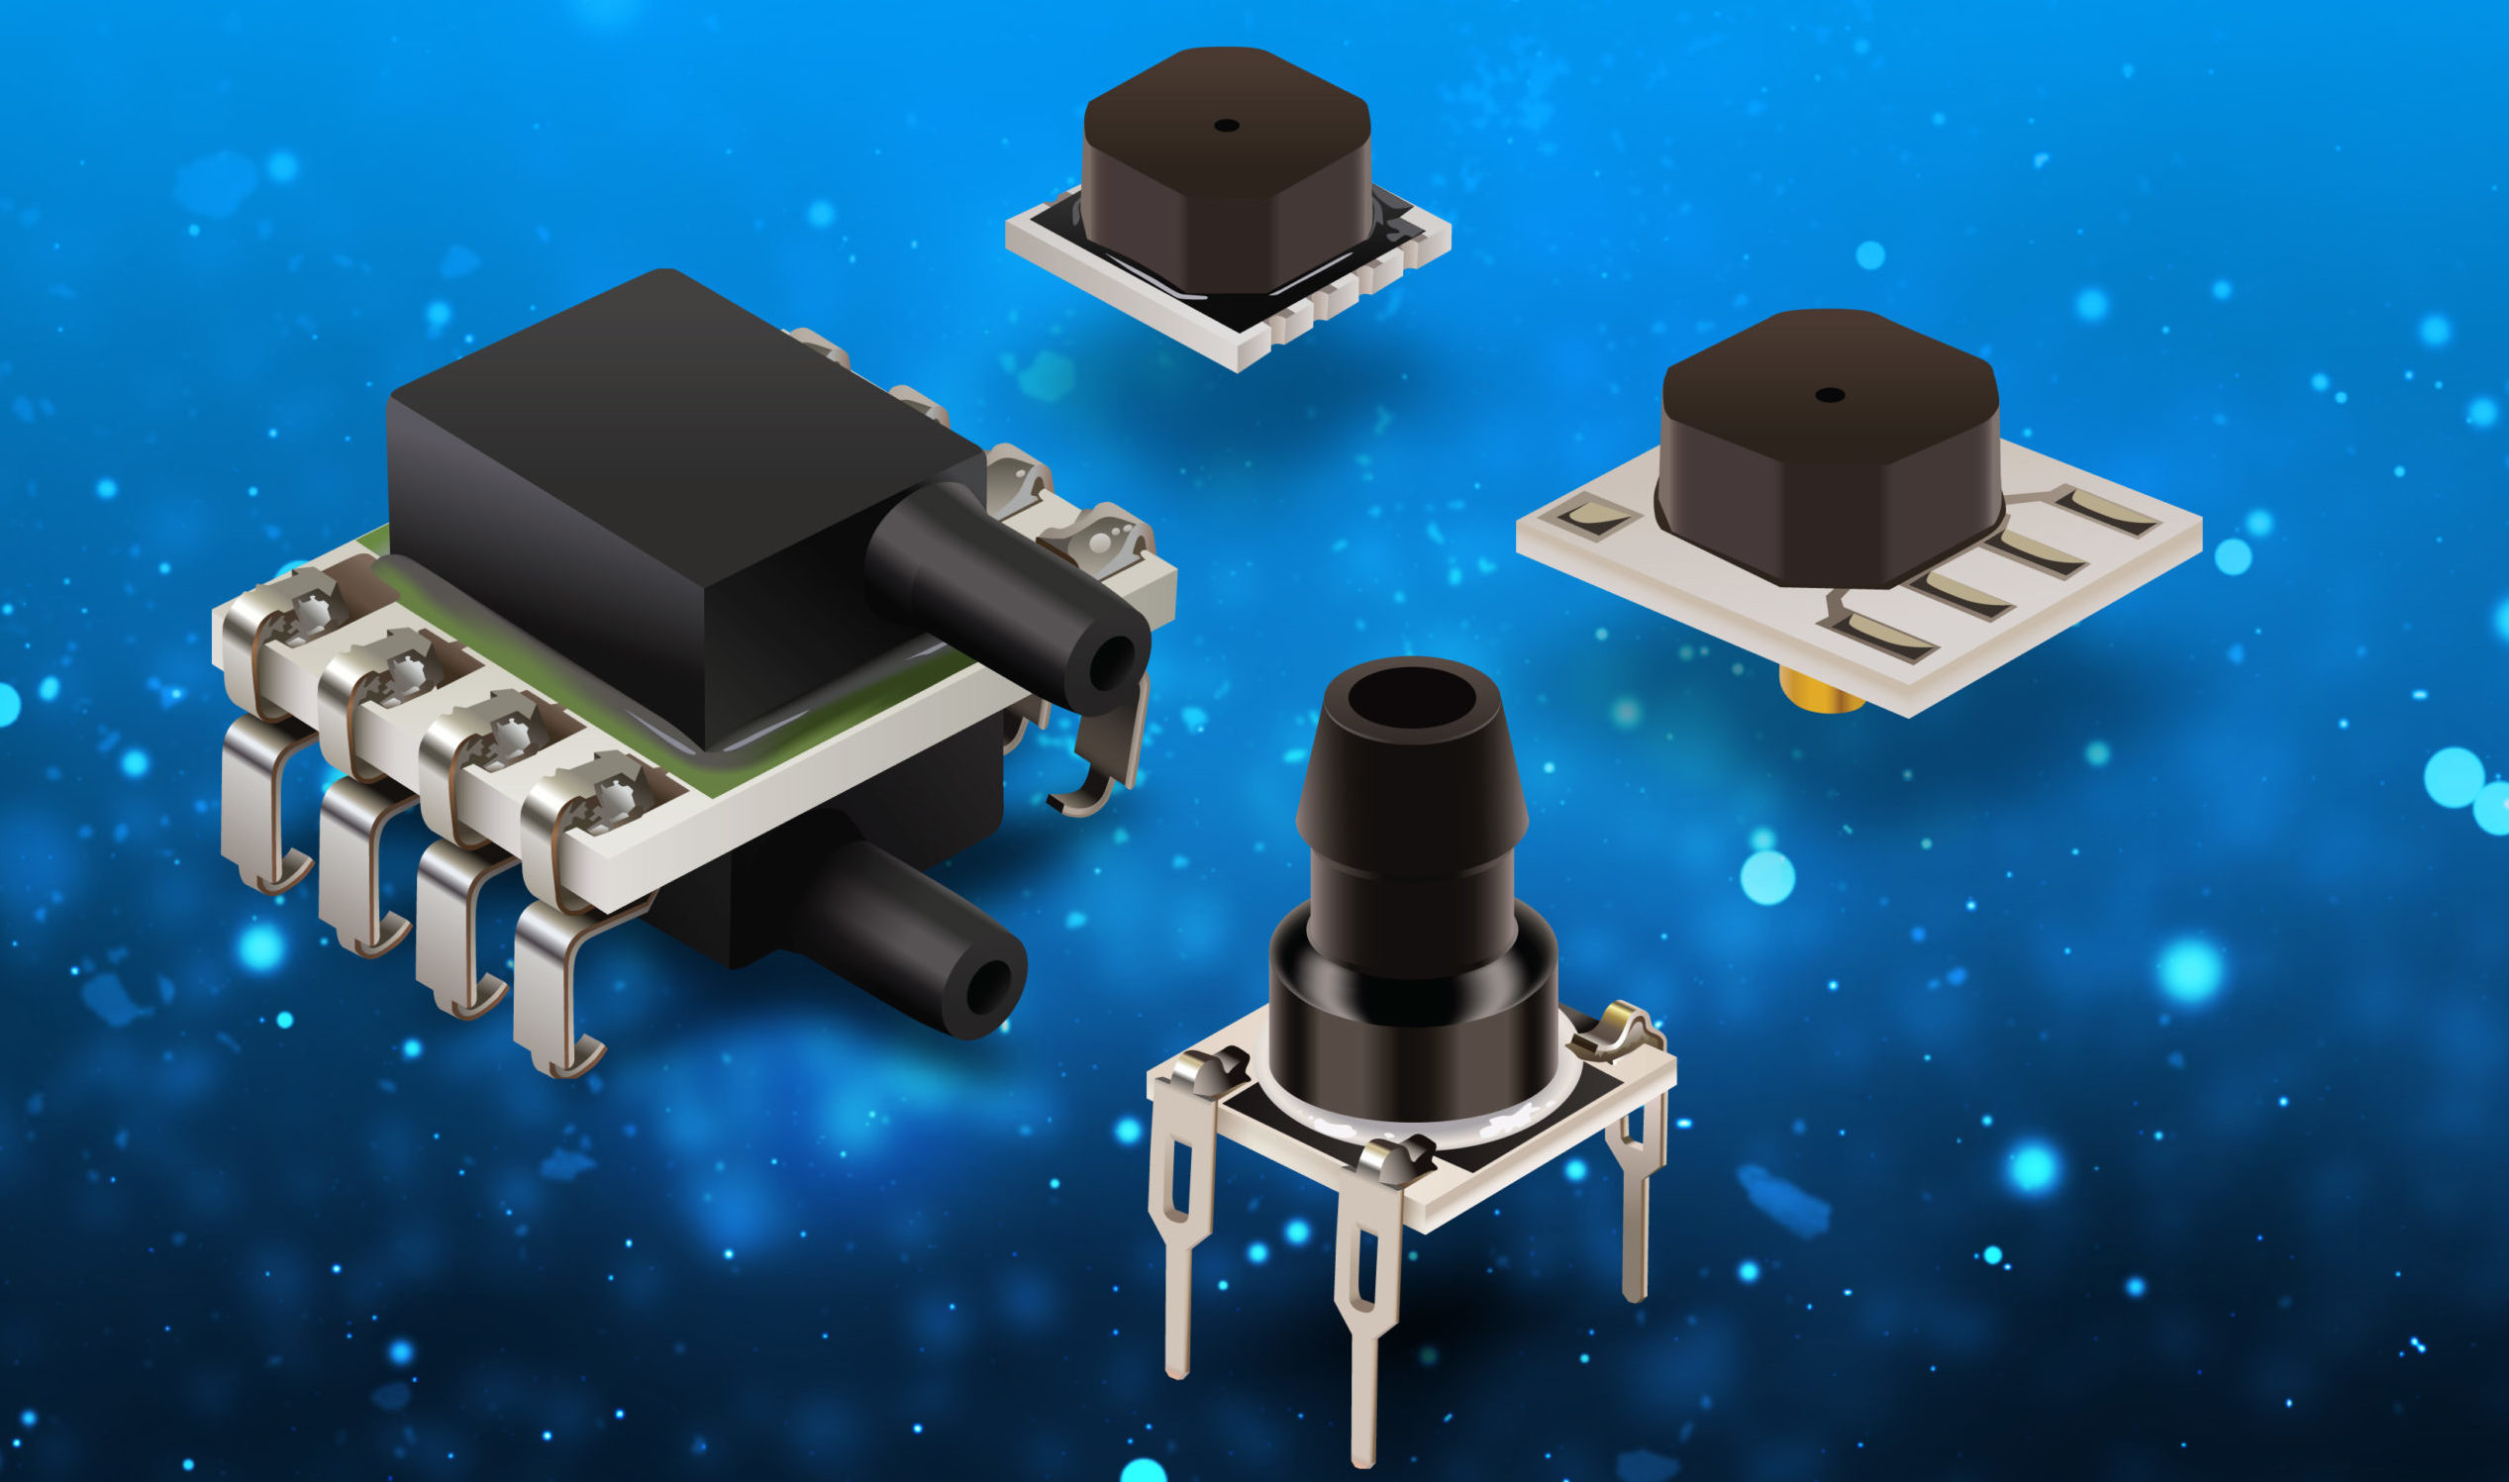
Types of Sensors Used:
Acoustic and Pneumatic Sensor
Moisture Sensor
Electrochemical Sensor
Resistivity Sensor
Soil NPK Transducer (Sensor)
Portable Soil Detector

Slide 7
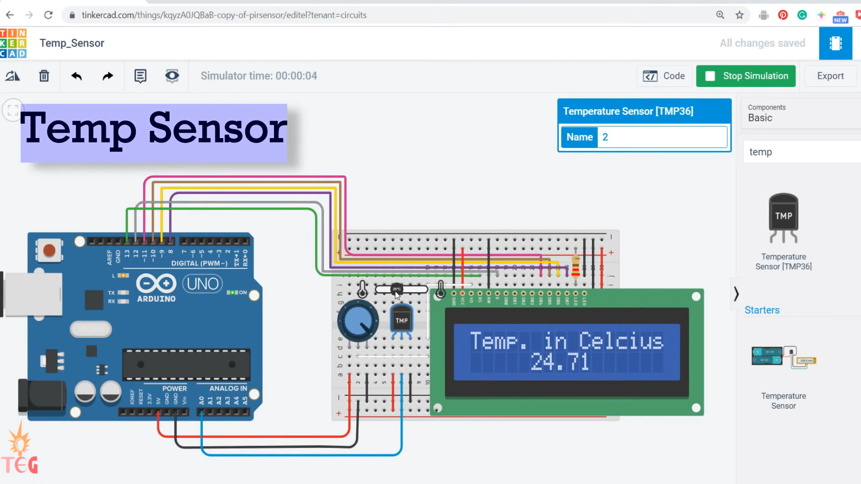
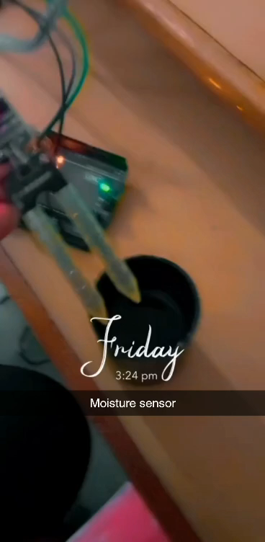
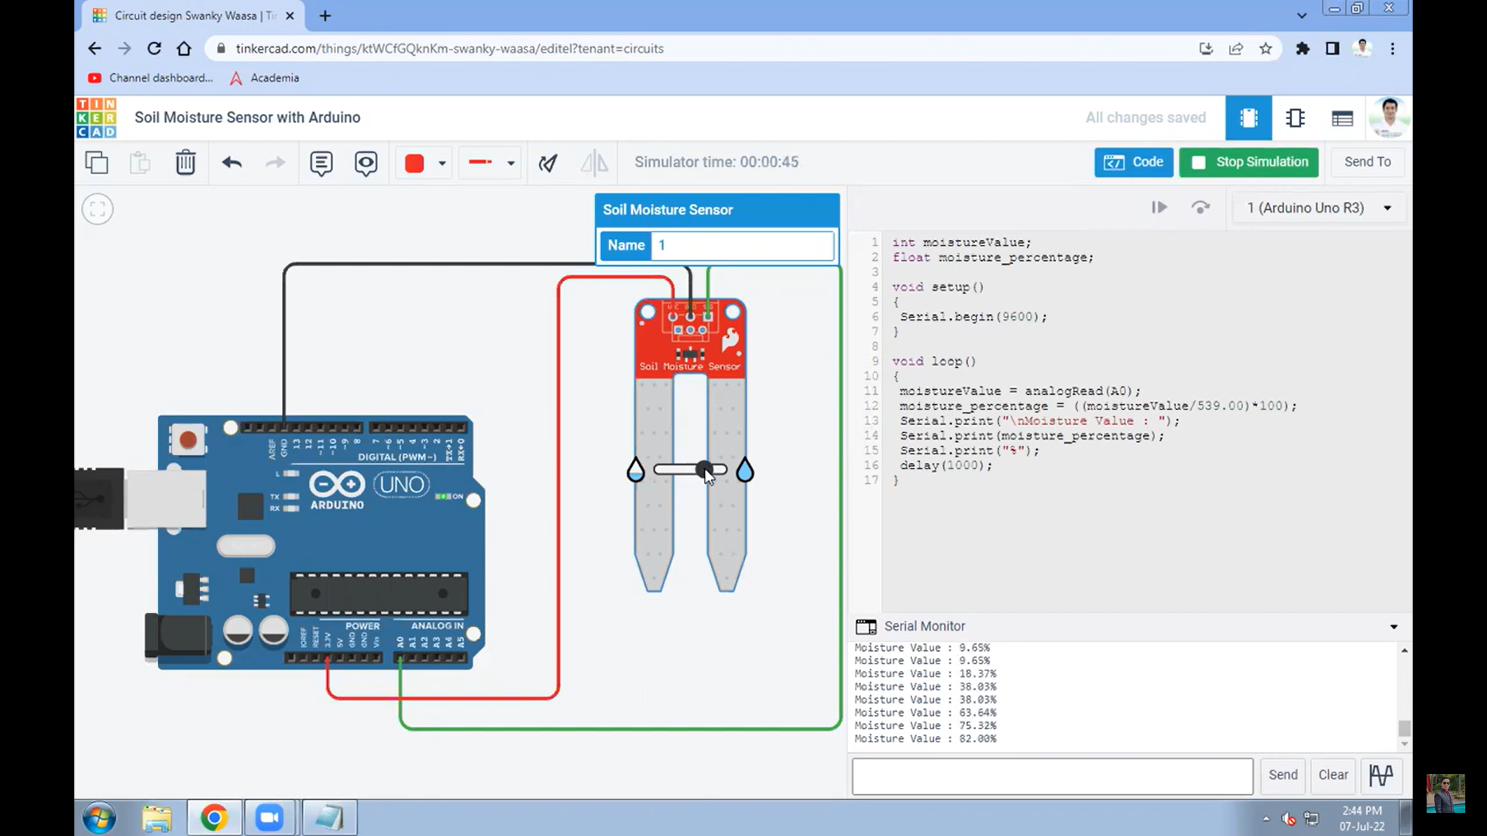
Moisture Sensor practicled
Some Sensor’s Used in virtual in Tinkercad Software

Slide 8
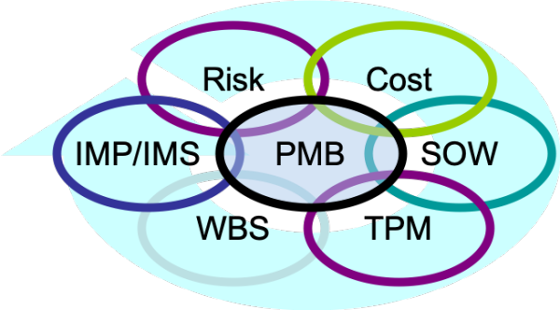
Adavantages:
Time reduce to check soil and water
No Guidance Need any Specialist
Optimise fertilizers use your crops
Proper Management of Water
Proper treatment for land

Slide 9

Prices of Sensors:
Acoustic and Pneumatic Sensor (upto 1.5K)
Moisture Sensor(0.5K)
Electrochemical Sensor (13 to 20K)
Resistivity Sensor (upto 1k)
Soil NPK Transducer (Sensor) (16+K)
Portable Soil Detector (5k)
Other Materials:
-Metal Sheets(5k)
-LCD Display(5K)
-Programme Setup
-Manufacturing Cost
-etc.
This Photo by Unknown Author is licensed under CC BY

Slide 10
Marketing :
-Social media
(what’s-App,Insta, etc.)
-Our WEBSITE
(Link-work in progress)
-Our Android APP
Start-up way:
-Manufacture Some Products
-Use special Agriculturist
- Go farmers farm and use it.(who can call)

